Slide 1
Explore data with Elasticsearch
Prepared by: Benny Cheung

Slide 2


Use Case - Problem
Covered analysts write call reports after visiting companies, clients and brokers.
As time goes by, a pile of call reports are stored in document repository.
As of 01st Jan 2019, there are more than 22,800 call reports stored in repository.

Slide 3
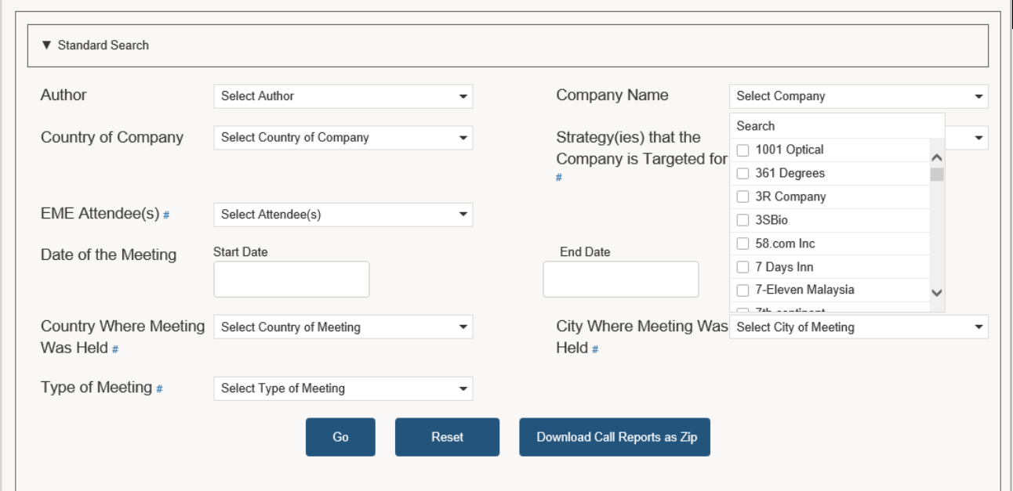

Use Case – Limitation of Call Reports Search
Limitation of call reports search
- Only fields search instead of full text search was available.
How can I get all the call reports in particular sector?
How can I search the report contents ?
Portfolio Managers & Analysts

Slide 4


Use Case – Limitation of Call Reports Search
Can I search for “ESG”?
Can I get those call reports about “Electric car”?
Sorry, call reports search doesn’t support this feature. We will think about it.
Portfolio Managers & Analysts
EME IT Team

Slide 5
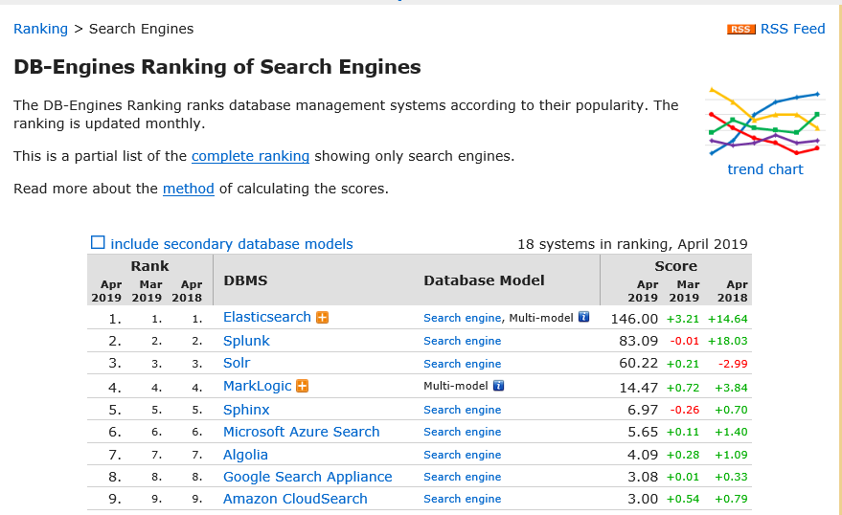
Evaluation of different search options
https://db-engines.com/en/ranking/search+engine

Slide 6



Evaluation of different search options
People all around the world, across virtually every industry are leveraging the power of Elasticsearch to do work.
MEDIA & ENTERTAINMENT
BANKING & FINANCE
TECHNOLOGY INDUSTRY
MEDIA & ENTERTAINMENT
Goldman Sachs
ING
FICO
GitHub
Microsoft
CISCO
Mozilla
Facebook
McGraw Hill
The New York Times

Slide 7
Evaluation of different search options
One of our folk, Priyanka, has experience in implementing an Elasticsearch application
The basic version of Elasticsearch is
Free of Charge

Slide 8
What is Elasticsearch?
open-source
runs on top of Apache Lucene.
“search engine software”.
provides the realistic potential to run our own search engine service (like Bing or Google).

Slide 9
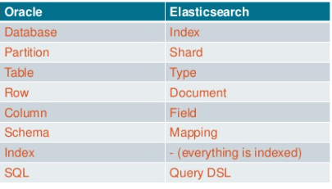
Elastic search vs RDBMS
Elastic search is a NO SQL data store
It has no relations, no constraints, no joins, no transactional behavior
Easier to Scale as compared to a relational Database
Some Elastic Search terminologies (in the context of an RDBMS):

Slide 10
What makes the search so fast?
Inverted Index and Index Term
Index
Term | Freq. | Doc.
winter | 1 | 1
is | 1 | 1
coming | 1 | 1
Term | Freq. | Doc.
1: Winter is coming.
Tokenize
Winter
is
coming
Indexing

Slide 11
What makes the search so fast?
Inverted Index and Index Term
Index
Term | Freq | Doc
winter | 1 | 1
is | 1 | 1
coming | 1 | 1
Term | Freq | Doc
winter | 1 | 1
is | 2 | 1,2
coming | 1 | 1
ours | 1 | 2
the | 1 | 2
fury | 1 | 2
2: Ours is the fury.
Tokenize
Ours
is
the
Indexing
fury

Slide 12
What makes the search so fast?
Inverted Index and Index Term
Index
Term | Freq | Doc
winter | 1 | 1
is | 2 | 1,2
coming | 1 | 1
ours | 1 | 2
the | 1 | 2
fury | 1 | 2
Term | Freq | Doc
winter | 1 | 1
is | 3 | 1,2,3
coming | 1 | 1
ours | 1 | 2
the | 2 | 2,3
fury | 1 | 2
choice | 1 | 3
yours | 1 | 3
3: The choice is yours.
Tokenize
The
Choice
is
Indexing
yours

Slide 13
What makes the search so fast?
To search all three documents for the words “is coming”, it would intersect those sets, coming up with the only matching set Document 1.
Term | Freq | Doc
Winter | 1 | 1
is | 3 | 1,2,3
coming | 1 | 1
ours | 1 | 2
the | 2 | 2,3
fury | 1 | 2
choice | 1 | 3
yours | 1 | 3

Slide 14
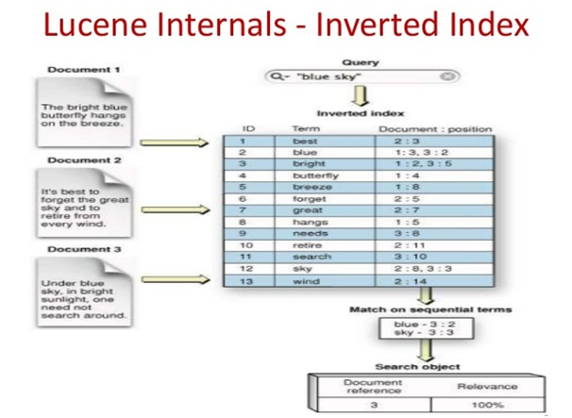
How LUCENE INVERTED INDEX is used for SEARCH

Slide 15
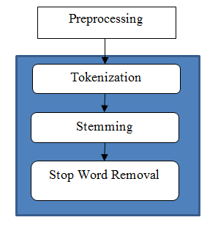
TOKENIZERS, ANALYZERS, FILTERS and more…
Its not only the inverted index that makes the search faster…
Elastic search organizes tokens for each term
There are numerous analyzers available to strip and analyze tokens
It borrows from NLP (natural language processing) for effective storage of terms

Slide 16
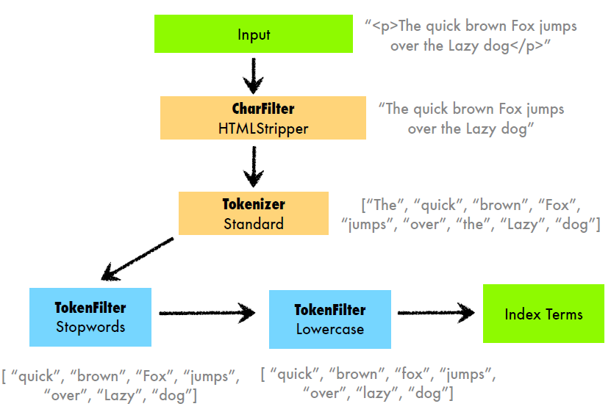
TOKENIZERS, ANALYZERS, FILTERS and more…

Slide 17
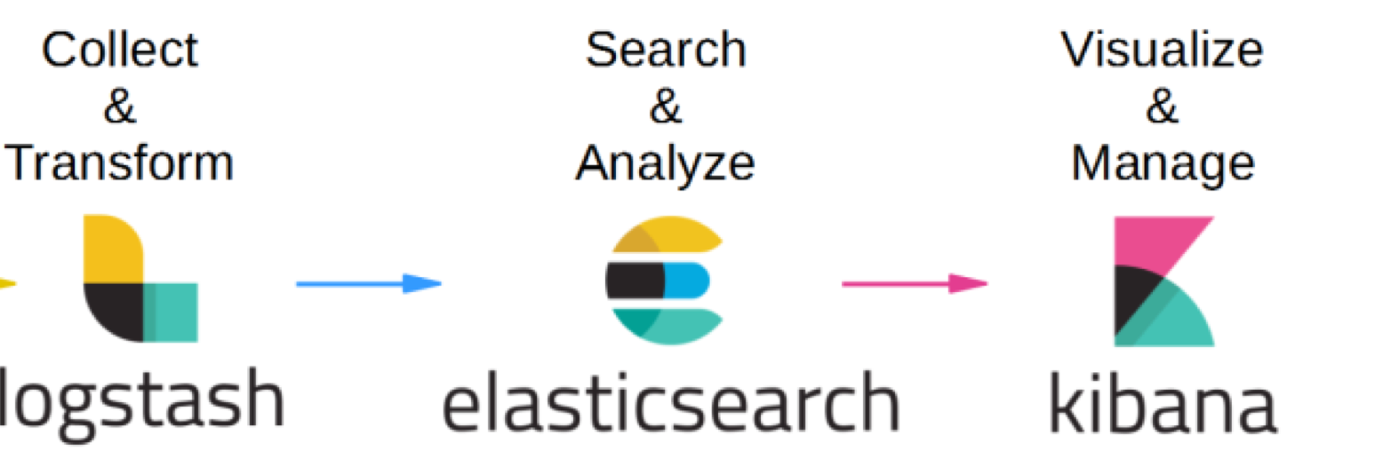
Elastic in EMERGING MARKETS EQUITY Applications
EME Uses the E(lastic) L(ogstash) K(ibana) stack version 6.6
2 nodes ( 1 Primary and 1 DR node with data replication)
Ingest pipeline for ingesting attachments like pdf, doc(x) files etc.
ELASTIC NEST API 7.2.0 to index and query Elastic Engine

Slide 18






Integration into Emerging Markets Equity Apps
Documents (doc, docx) are ingested into Elasticsearch.
“Keyword” search function fires the http request and Web Service transforms the request to query DSL before pushing forward to Elasticsearch.
Search results are then showed in client page.
EME Metadata + Call reports
doc Ingestion
Query layer and Analytics
Query DSL
Http request
Search results
Elastic client (NEST)
JSON response
Web Service

Slide 19

Integration into Emerging Markets Equity Apps
Elasticsearch Architecture in EME Apps
Web Service
Master Node
Implement in next phase
Replication
Coordinator
Data Node
ELASTICSEARCH CLUSTER

Slide 20
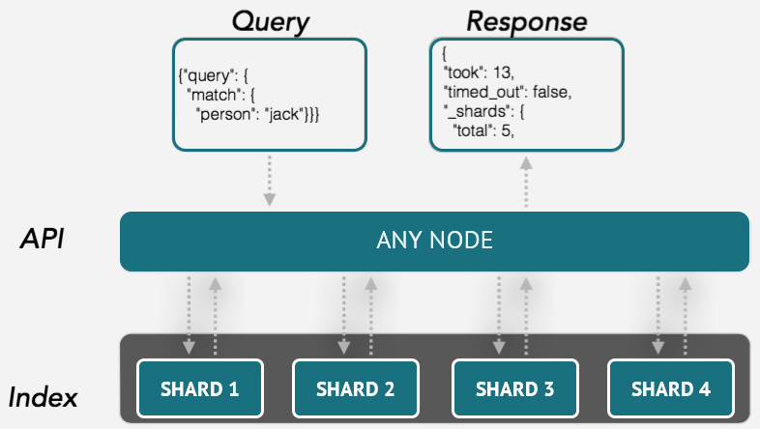
Elastic Query (Request and Repsonse)
This is how a typical Elastic Search query works:

Slide 21
Integration into Emerging Markets Equity Apps
To build the index from EME Call Reports
EME Metadata + Call Reports
Convert each Word file to base64String
Parallel.ForEach(callReportsCollection, callReport =>
{
var base64File = Convert.ToBase64String(File.ReadAllBytes(callReport));
var fileSavedName = callReport.Replace(directory, "");
var dt = dLCallReportSearch.GetCallFileName(fileSavedName.Replace(“’”,
…
Doc Ingestion

Slide 22
Integration into Emerging Markets Equity Apps
To build the index from EME Call Reports
EME Metadata + Call Reports
Creating attributes of each call report
PUT /emeelasticsearch/_doc/1
{
“Author" : “Peter Wong“
“Company” : “Brilliance China”
“Strategy” : “China”
“Country of Country” : “ China”
…
}
Doc Ingestion

Slide 23
Integration into Emerging Markets Equity Apps
To build the index from EME Call Reports
EME Metadata + Call Reports
Config and import each call report into Elasticsearch
## import the attachment into Elasticsearch
PUT /attachment_test/my_type/1?pipeline=attachment
{
"data": "UEsDBBQABgAIAAAAIQDfpNJsWgEAACAFAAATAAgCW0NvbnRlbnRfVHlwZXNdLnhtbCCiB…..
}
Doc Ingestion
Doc content in base64 format

Slide 24
Integration into Emerging Markets Equity Apps
To search for a keyword in Call Reports
Converting the request to Query DSL
GET /documents/document/_search?pretty=true
{
"query": {
"bool":{
"must":
{
"multi_match" : {
"query": "Electric Car",
"fields": [ "title","companyName","attachment.content" ]
…
}
Keyword Search for “Electric Car”
"query": "Electric Car",
Query layer and Analytics
Query DSL
Http request
Elastic client (NEST)
Web Service

Slide 25
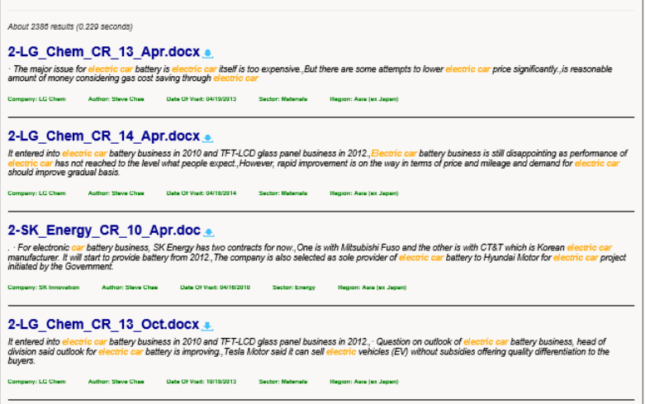
Integration into Emerging Markets Equity Apps
To search for a keyword (Electric car) in Call Reports
Query layer and Analytics
Query DSL
Http request
Search results
Elastic client (NEST)
JSON response
Web Service

Slide 26
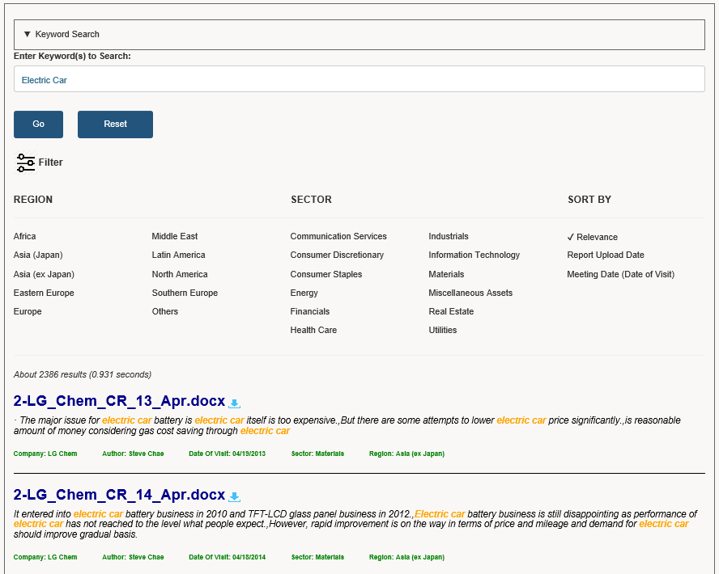
Integration into Emerging Markets Equity Apps
Keyword Search
Consecutive Filtering
Sorting order preference
Search results

Slide 27
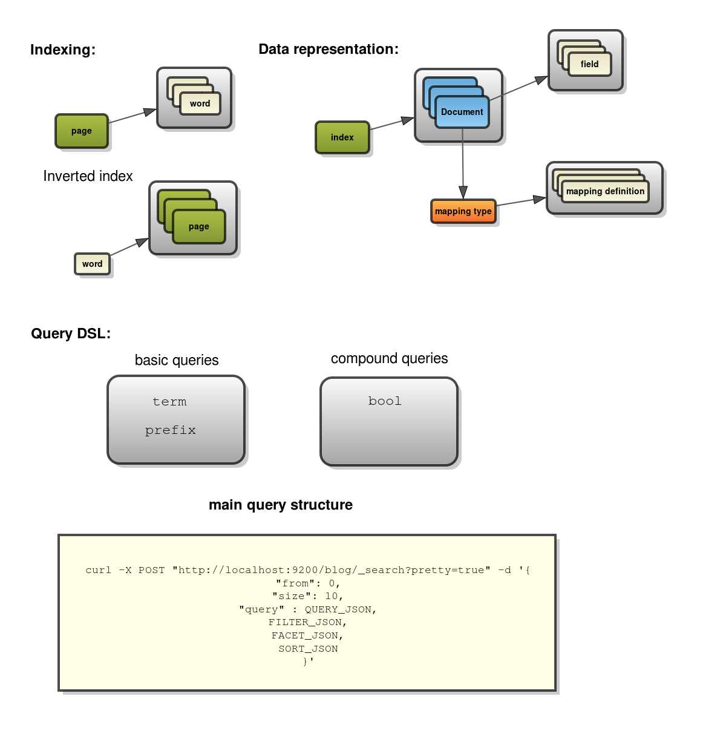
The entire ELASTIC LIFECYCLE in a NUTSHELL
We can summarize the entire elastic engine CYCLE (from index creation to querying) as follows:

Slide 28
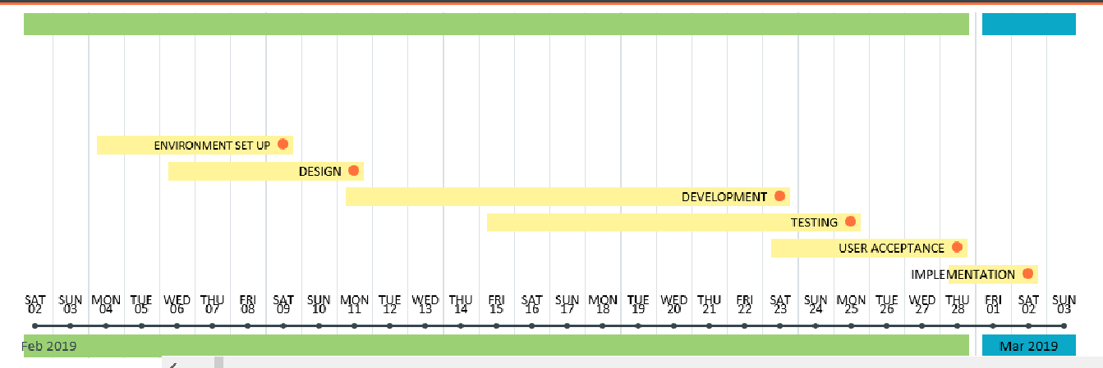

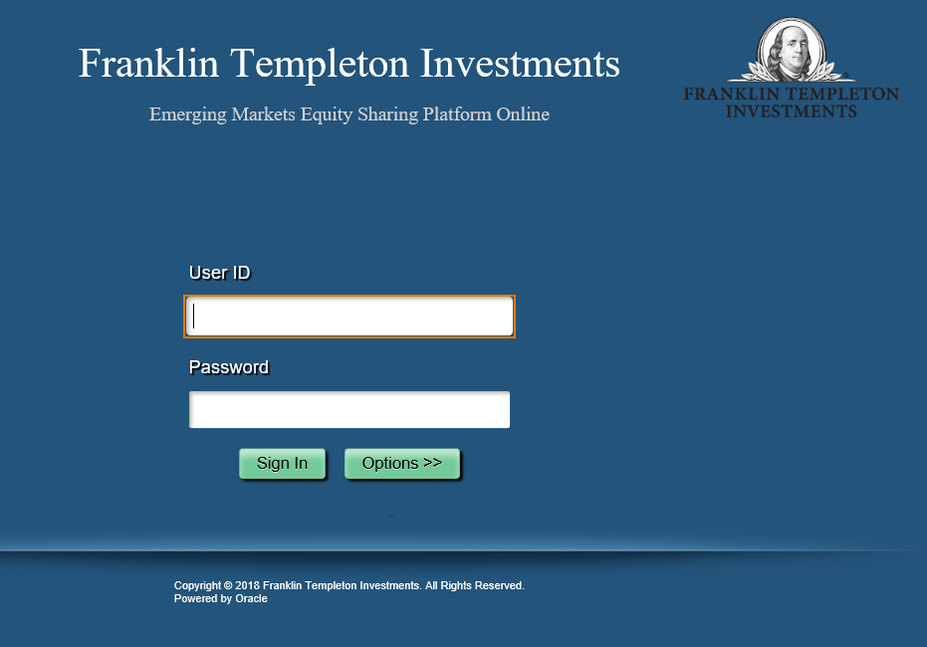

The Fact…
Development Cycle
Ideas and Initiatives
Go live

Slide 29
The Fact…
No. of documents ingested to Elasticsearch: Around 22,700
Size of data files generated by Elasticsearch: Around 98 MB
Search Keyword: “Electric Car”
2386 results found.
It only takes 931 milliseconds.

Slide 30
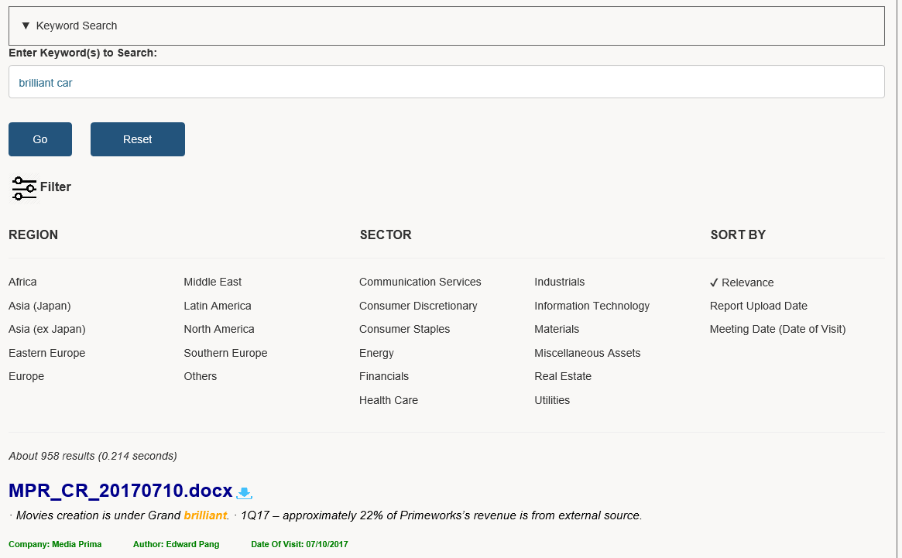
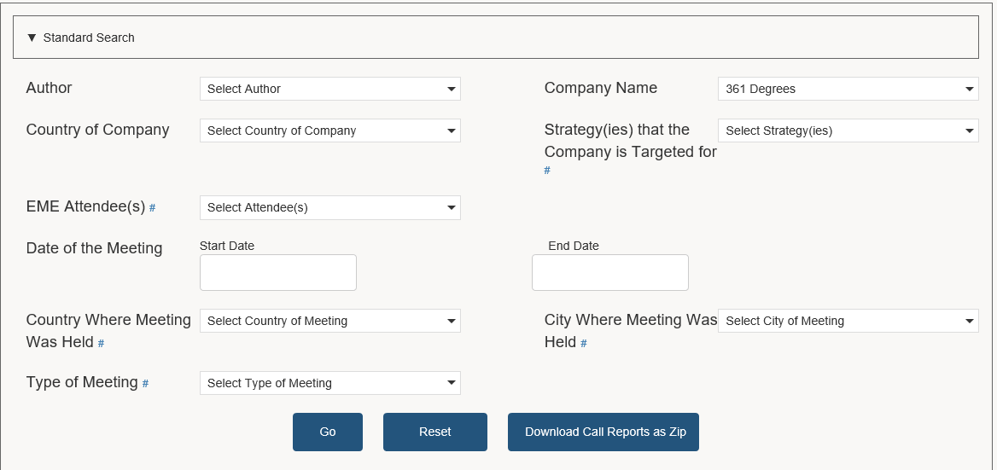
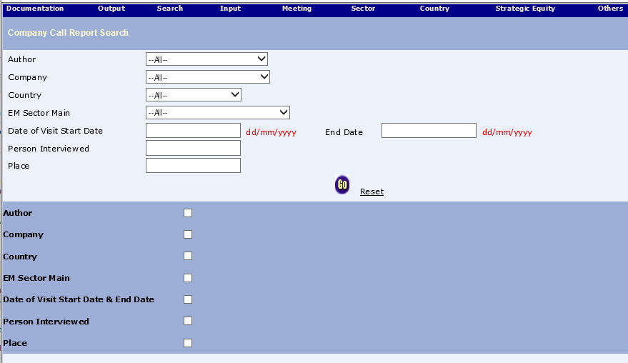
Call Reports Search Evolution
Milestones of Call Reports Search
Elasticsearch tool
Angular search tool
HTML search tool
| | | | | | | | | | | | | | | | | | | | | | | | | | | | | | | | | | | | |
| | | | | | | | | | | |
2003
2018
2019

Slide 31

What’s Next?
Further expand the Elasticsearch usage to other areas. For example, analyst’s stock recommendation, company documentation.
Implement autocomplete feature based on metadata of call reports to the search input box.
Use Logstash to import Data from RDBMS to Elastic

Slide 32
How AutoComplete works?
Query layer and Analytics
EME Metadata loads to
Elasticsearch. For example,
Franklin Templeton Office
EME Metadata + Call Reports
Passes “Location”
value to Edge
Ngram tokenizer
Tokenizer will save
the Location value
which is broken
down to list of
specified characters
to elastic.
Tokenizer will break the value of the “location” parameters
as follows:
1 Fra
2 Fran
3 Frank
4 Frankl
5 Frankli
6 Franklin
7 Tem
8 Temp
9 Templ
10 Temple
11 Templet
12 Templeto
13 Templeton
14 off
15 offi
16 offic
17 office

Slide 33
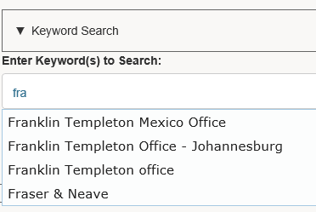
How AutoComplete works?
Query layer and Analytics
Search for fra
Query DSL
Elastic client (NEST)
JSON Response
Search Results
Autocomplete
suggestions as
user types “fra”

Slide 34

Q & A

